Slide 1
Decision Trees
Greedy, Non-Parametric, Multi-Class Classification Technique

Slide 2
CART
CLASSIFICATION AND REGRESSION TREES
Classification Trees
Regression Tress

Slide 3
About:
Very old technique
This technique has become a basis for more sophisticated Classification Techniques such as:
Random Forests
Gradient Boosting
Works on the principal of Entropy Minimization

Slide 4
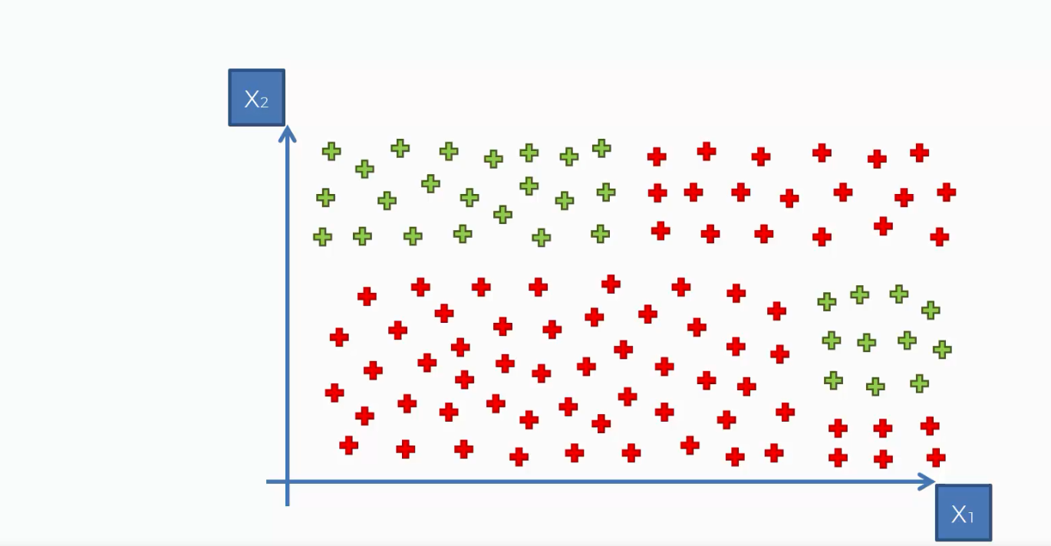
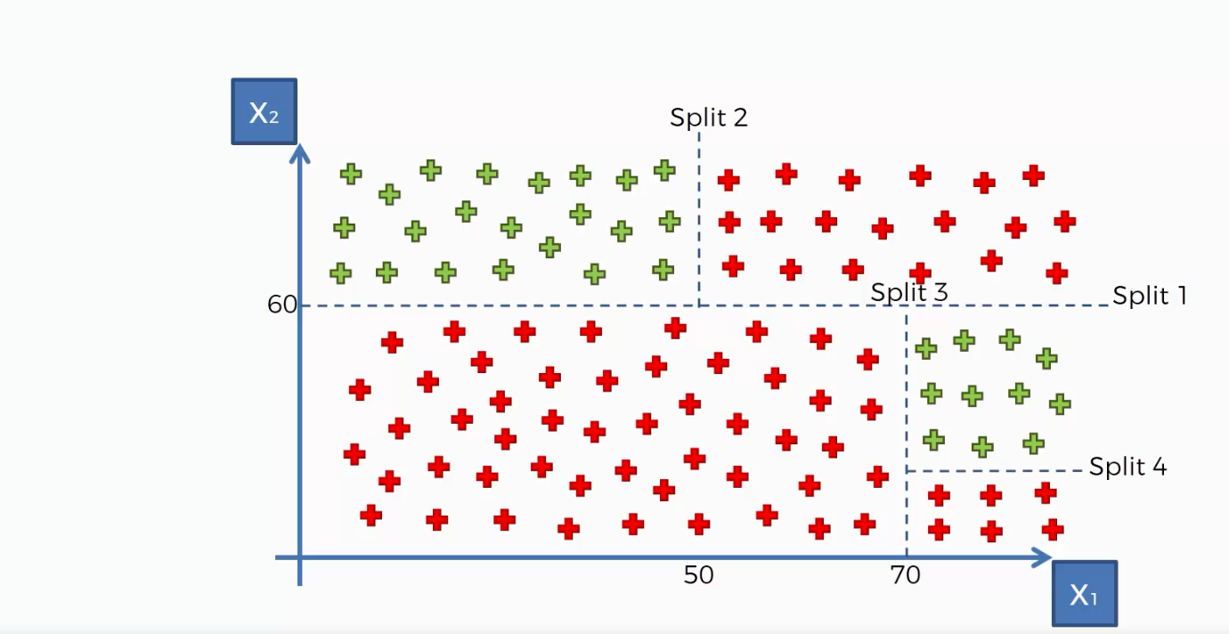
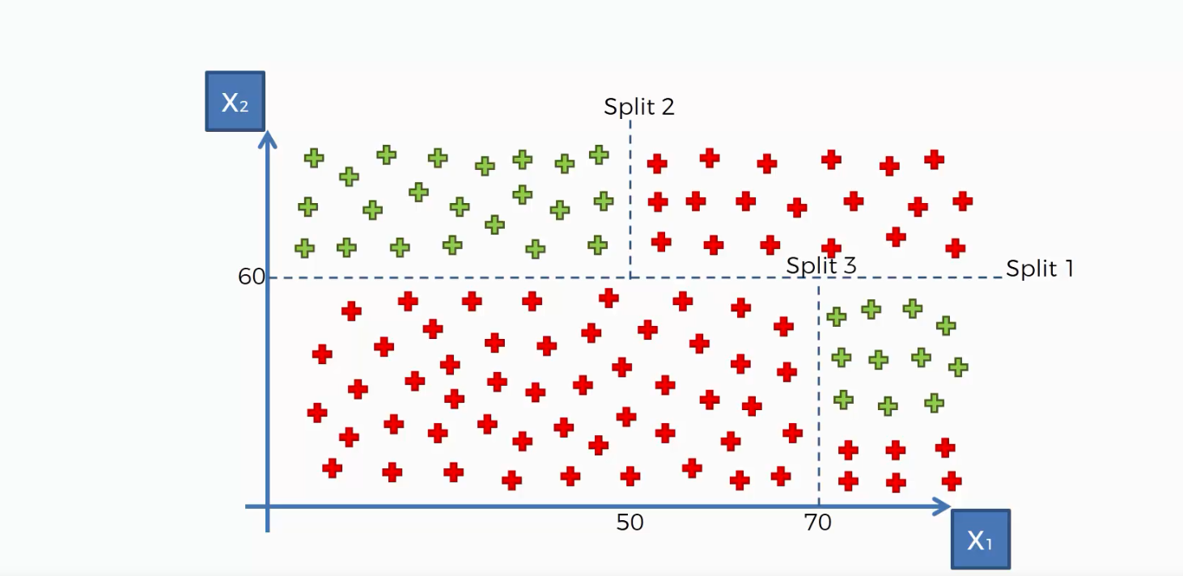


Slide 5
Decision Trees
Root Node: It represents entire population or sample and this further gets divided into two or more homogeneous sets.
Splitting: It is a process of dividing a node into two or more sub-nodes.
Decision Node: When a sub-node splits into further sub-nodes, then it is called decision node.
Leaf/ Terminal Node: Nodes do not split is called Leaf or Terminal node.
Pruning: When we remove sub-nodes of a decision node, this process is called pruning. You can say opposite process of splitting.
Branch / Sub-Tree: A sub section of entire tree is called branch or sub-tree.
Parent and Child Node: A node, which is divided into sub-nodes is called parent node of sub-nodes where as sub-nodes are the child of parent node.

Slide 6
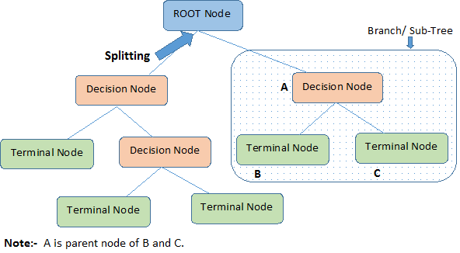
Trees (Diagram)

Slide 7
Entropy Minimization
Finding out the greatest differentiator amongst all the input variables so that the population dataset can be divided into sub-populations with minimum entropy.
This means, the sub-populations should be Homogeneous (and Heterogeneous to each other).
The best differentiator is chosen to divide the dataset into different nodes of the parent dataset.
The process is repeated until all sub-populations are homogeneous.

Slide 8
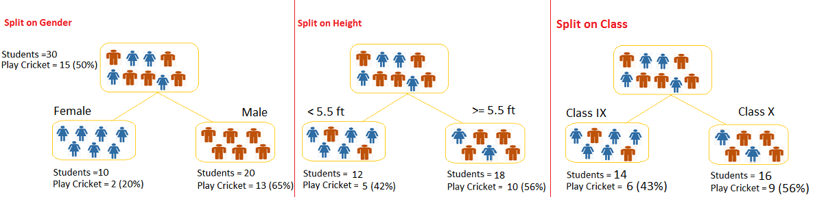
Entropy Minimization (Example)
Let’s say we have a sample of 30 students with three variables Gender (Boy/ Girl), Class( IX/ X) and Height (5 to 6 ft.). 15 out of these 30 play cricket in leisure time. Now, I want to create a model to predict who will play cricket during leisure period? In this problem, we need to segregate students who play cricket in their leisure time based on highly significant input variable among all three

Slide 9
Techniques of Division/Splitting
Gini Index
Chi-Square
Information Gain

Slide 10
Gini Index
It works with categorical target variable “Success” or “Failure”.
It performs only Binary splits
Higher the value of Gini Index, higher the homogeneity.
CART (Classification and Regression Tree) uses Gini Index method by default to create binary splits.

Slide 11
Steps to Calculate Gini Index for a split
Calculate Gini for sub-nodes, using formula sum of square of probability for success and failure (p^2+q^2).
Calculate Gini for split using weighted Gini score of each node of that split

Slide 12
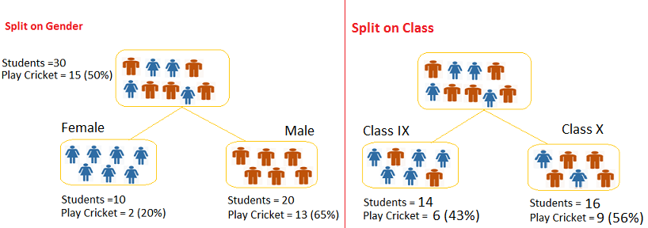
Example

Slide 13
Calculating the Gini Index (Example)
Split on Gender:
Calculate, Gini for sub-node Female = (0.2)*(0.2)+(0.8)*(0.8)=0.68
Gini for sub-node Male = (0.65)*(0.65)+(0.35)*(0.35)=0.55
Calculate weighted Gini for Split Gender = (10/30)*0.68+(20/30)*0.55 = 0.59
Similar for Split on Class:
Gini for sub-node Class IX = (0.43)*(0.43)+(0.57)*(0.57)=0.51
Gini for sub-node Class X = (0.56)*(0.56)+(0.44)*(0.44)=0.51
Calculate weighted Gini for Split Class = (14/30)*0.51+(16/30)*0.51 = 0.51
Based on the calculations above, we can see that Gini score for Split on Gender is higher than Split on Class, hence, the node split will take place on Gender.

Slide 14
Chi-Square
It is an algorithm to find out the statistical significance between the differences between sub-nodes and parent node. We measure it by sum of squares of standardized differences between observed and expected frequencies of target variable.
Features:
It works with categorical target variable “Success” or “Failure”.
It can perform two or more splits.
Higher the value of Chi-Square higher the statistical significance of differences between sub-node and Parent node.
It generates tree called CHAID (Chi-square Automatic Interaction Detector)

Slide 15
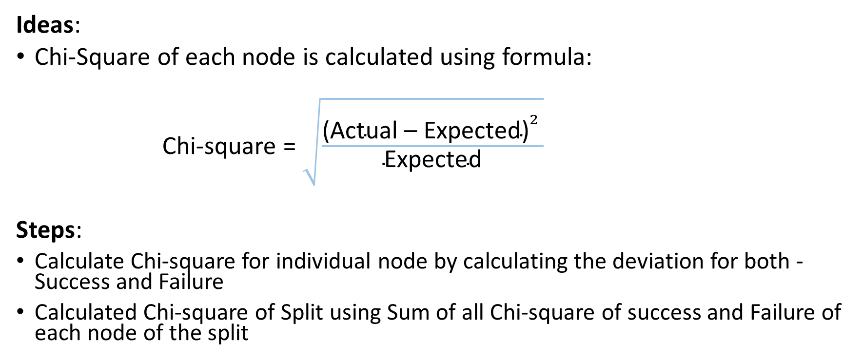
Steps to Calculate Chi-square for a split
Ideas:
Chi-Square of each node is calculated using formula:
Chi-square = $\sqrt{\frac{{\text{(}\text{Actual}\text{ – }\text{Expected}\text{)}}^{2} }{\text{Expected}}}$
Steps:
Calculate Chi-square for individual node by calculating the deviation for both - Success and Failure
Calculated Chi-square of Split using Sum of all Chi-square of success and Failure of each node of the split

Slide 16
Example Steps (Split on Gender)
First we are populating for node Female, Populate the actual value for “Play Cricket” and “Not Play Cricket”, here these are 2 and 8 respectively.
Calculate expected value for “Play Cricket” and “Not Play Cricket”, here it would be 5 for both because parent node has probability of 50% and we have applied same probability on Female count(10).
Calculate deviations by using formula, Actual – Expected. It is for “Play Cricket” (2 – 5 = -3) and for “Not play cricket” ( 8 – 5 = 3).
Calculate Chi-square of node for “Play Cricket” and “Not Play Cricket” using formula with formula, = ((Actual – Expected)^2 / Expected)^1/2. You can refer below table for calculation.
Follow similar steps for calculating Chi-square value for Male node.
Now add all Chi-square values to calculate Chi-square for split Gender.

Slide 17
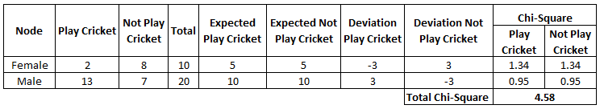
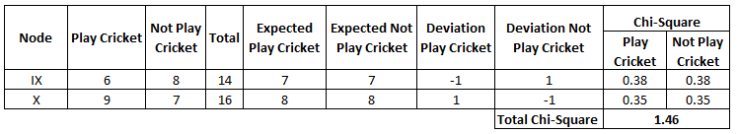
Comparing the Chi-Square Values
Split on Gender
Split on Class
Based on the calculations above, we can see that Chi-Square for Split on Gender is higher than Split on Class, hence, the node split will take place on Gender.

Slide 18
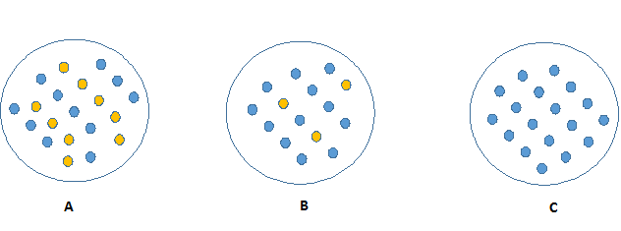
Information Gain (Entropy Minimization)
From the figure above, it can be inferred that C is a Pure node since it requires less information to describe where as A needs relatively more information to be described fully. Hence its an Impure node. Now, we can build a conclusion that less impure node requires less information to describe it. And, more impure node requires more information. Information theory is a measure to define this degree of disorganization in a system known as Entropy. If the sample is completely homogeneous, then the entropy is zero and if the sample is an equally divided (50% – 50%), it has entropy of one.

Slide 19
Entropy
Entropy can be calculated using the following formula:
Entropy = - (p log₂ p) - (q log₂ q)
Here, p and q are probabilities of success and failure respectively for that node. Entropy is also used with categorical target variable. It chooses the split which has lowest entropy compared to parent node and other splits. The lesser the entropy, the better it is.
Steps to calculate entropy for a split:
Calculate entropy of parent node
Calculate entropy of each individual node of split and calculate weighted average of all sub-nodes available in split.

Slide 20
Example:
Entropy for Parent node = -(15/30) log2 (15/30) – (15/30) log2 (15/30) = 1.
Here, entropy of 1 shows that the parent is an impure node.
Entropy for Female node = -(2/10) log2 (2/10) – (8/10) log2 (8/10) = 0.72
Entropy for Male node, -(13/20) log2 (13/20) – (7/20) log2 (7/20) = 0.93
Entropy for split on Gender = Weighted entropy of sub-nodes = (10/30)*0.72 + (20/30)*0.93 = 0.86
Entropy for Class IX node, -(6/14) log2 (6/14) – (8/14) log2 (8/14) = 0.99
Entropy for Class X node, -(9/16) log2 (9/16) – (7/16) log2 (7/16) = 0.99
Entropy for split on Class = (14/30)*0.99 + (16/30)*0.99 = 0.99
We can see that entropy for Split on Gender is the lowest among all, so the tree will split on Gender. We can derive information gain from entropy as 1- Entropy.

Slide 21
Advantages
Easy to Understand: Decision tree output is very easy to understand even for people from non-analytical background. It does not require any statistical knowledge to read and interpret them. Trees can be visualized.
Useful in Data exploration: Decision tree is one of the fastest way to identify most significant variables and relation between two or more variables. With the help of decision trees, we can identify features that have better power to predict target variable. For example, we are working on a problem where we have information available in hundreds of variables, there decision tree will help to identify most significant variable.
Less data cleaning required: It requires less data cleaning compared to some other modeling techniques. It is not influenced by outliers to a fair degree. However, this module does not support missing values.
Data type is not a constraint: It can handle both numerical and categorical variables.
Uses a white box model. If a given situation is observable in a model, the explanation for the condition is easily explained by Boolean logic. By contrast, in a black box model (e.g., in an artificial neural network), results may be more difficult to interpret.

Slide 22
Challenges
Over fitting: Over fitting is one of the most practical difficulty for decision tree models. This problem gets solved by setting constraints on model parameters and pruning.
Not fit for continuous variables: While working with continuous numerical variables, decision tree loses information when it categorizes variables in different categories. Binning the continuous variables might lead to better results.
Unstable: Decision trees can be unstable because small variations in the data might result in a completely different tree being generated. This problem is mitigated by using decision trees within an ensemble.
Greedy Algorithm: The problem of learning an optimal decision tree is known to be NP-complete under several aspects of optimality and even for simple concepts. Consequently, practical decision-tree learning algorithms are based on heuristic algorithms such as the greedy algorithm where locally optimal decisions are made at each node. Such algorithms cannot guarantee to return the globally optimal decision tree. This can be mitigated by training multiple trees in an ensemble learner, where the features and samples are randomly sampled with replacement.
Biased Tree: Decision tree learners create biased trees if some classes dominate. It is therefore recommended to balance the dataset prior to fitting with the decision tree.

Slide 23
Avoiding Overfitting
Overfitting is one of the key challenges faced while modeling decision trees. If there is no limit set of a decision tree, it will give us an accuracy of 100% on training set, because in the worse case, it will end up making 1 leaf for each observation. Thus, preventing overfitting is pivotal while modeling a decision tree and it can be done in 2 ways:
Setting constraints on tree size
Here, we set up some constraints which when satisfied, can stop further splitting of the parent node into child nodes.
As discussed earlier, the technique of setting constraint is a greedy-approach. In other words, it will check for the best split instantaneously and move forward until one of the specified stopping condition is reached.

Slide 24
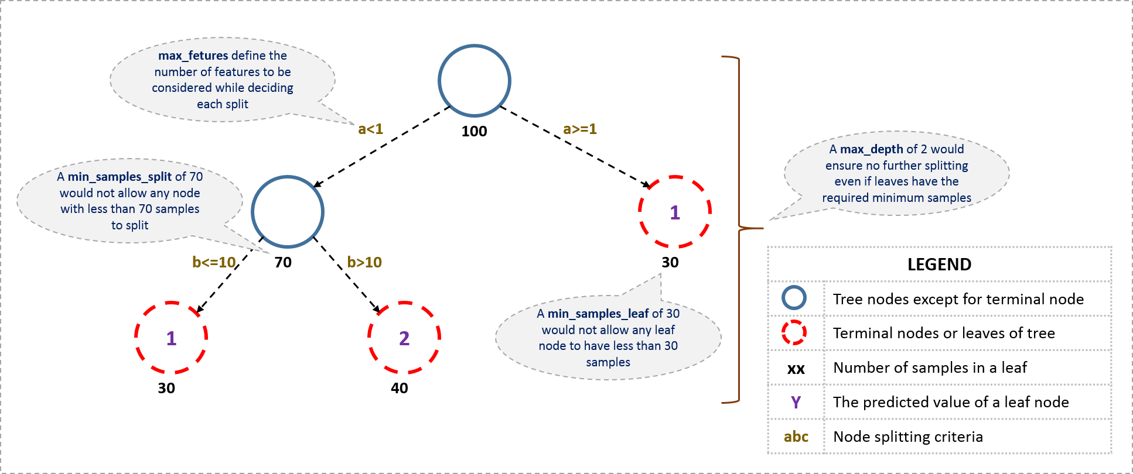
Decision Tree - General Structure

Slide 25
Setting up Constraints:
Minimum samples for a node split
Defines the minimum number of samples (or observations) which are required in a node to be considered for splitting.
Used to control over-fitting. Higher values prevent a model from learning relations which might be highly specific to the particular sample selected for a tree.
Too high values can lead to under-fitting hence, it should be tuned using CV.
Minimum samples for a terminal node (leaf)
Defines the minimum samples (or observations) required in a terminal node or leaf.
Used to control over-fitting similar to min_samples_split.
Generally lower values should be chosen for imbalanced class problems because the regions in which the minority class will be in majority will be very small.
Maximum depth of tree (vertical depth)
The maximum depth of a tree.
Used to control over-fitting as higher depth will allow model to learn relations very specific to a particular sample.
Should be tuned using CV.
Maximum number of terminal nodes
The maximum number of terminal nodes or leaves in a tree.
Can be defined in place of max_depth. Since binary trees are created, a depth of ‘n’ would produce a maximum of 2^n leaves.
Maximum features to consider for split
The number of features to consider while searching for a best split. These will be randomly selected.
As a thumb-rule, square root of the total number of features works great but we should check up to 30-40% of the total number of features.
Higher values can lead to over-fitting but depends on case to case.

Slide 26
Tree Pruning
STEPS:
We first make the decision tree to a large depth.
Then we start at the bottom and start removing leaves which are giving us negative returns when compared from the top.
Suppose a split is giving us a gain of say -10 (loss of 10) and then the next split on that gives us a gain of 20. A simple decision tree will stop at step 1 but in pruning, we will see that the overall gain is +10 and keep both leaves.
Note that in Python, sklearn library’s decision tree classifier does not currently support pruning.
Advanced packages like xgboost have adopted tree pruning in their implementation.

Slide 27
Classification vs. Regression Trees
Classification | Regression
Classification trees are used when dependent variable is categorical. | Regression trees are used when dependent variable is continuous.
In case of classification tree, the value (class) obtained by terminal node in the training data is the mode of observations falling in that region. Thus, if an unseen data observation falls in that region, we’ll make its prediction with mode value. | In case of regression tree, the value obtained by terminal nodes in the training data is the mean response of observation falling in that region. Thus, if an unseen data observation falls in that region, we’ll make its prediction with mean value.
Both the trees divide the predictor space (independent variables) into distinct and non-overlapping regions. For the sake of simplicity, you can think of these regions as high dimensional boxes or boxes.
Both the trees follow a top-down greedy approach known as recursive binary splitting. We call it as ‘top-down’ because it begins from the top of tree when all the observations are available in a single region and successively splits the predictor space into two new branches down the tree. It is known as ‘greedy’ because, the algorithm cares (looks for best variable available) about only the current split, and not about future splits which will lead to a better tree.
This splitting process is continued until a user defined stopping criteria is reached. For example: we can tell the algorithm to stop once the number of observations per node becomes less than 50.
In both the cases, the splitting process results in fully grown trees until the stopping criteria is reached. But, the fully grown tree is likely to overfit data, leading to poor accuracy on unseen data.

Slide 28
Tree Visualization
Once trained, we can export the tree in Graphviz format using the export_graphviz exporter.
If you use the conda package manager, the graphviz binaries and the python package can be installed with
conda install python-graphviz
Below is an example graphviz export of the above tree trained on the entire iris dataset; the results are saved in an output file iris.pdf:
>>> import graphviz
>>> dot_data = tree.export_graphviz(clf, out_file=None)
>>> graph = graphviz.Source(dot_data)
>>> graph.render("iris")

Slide 29
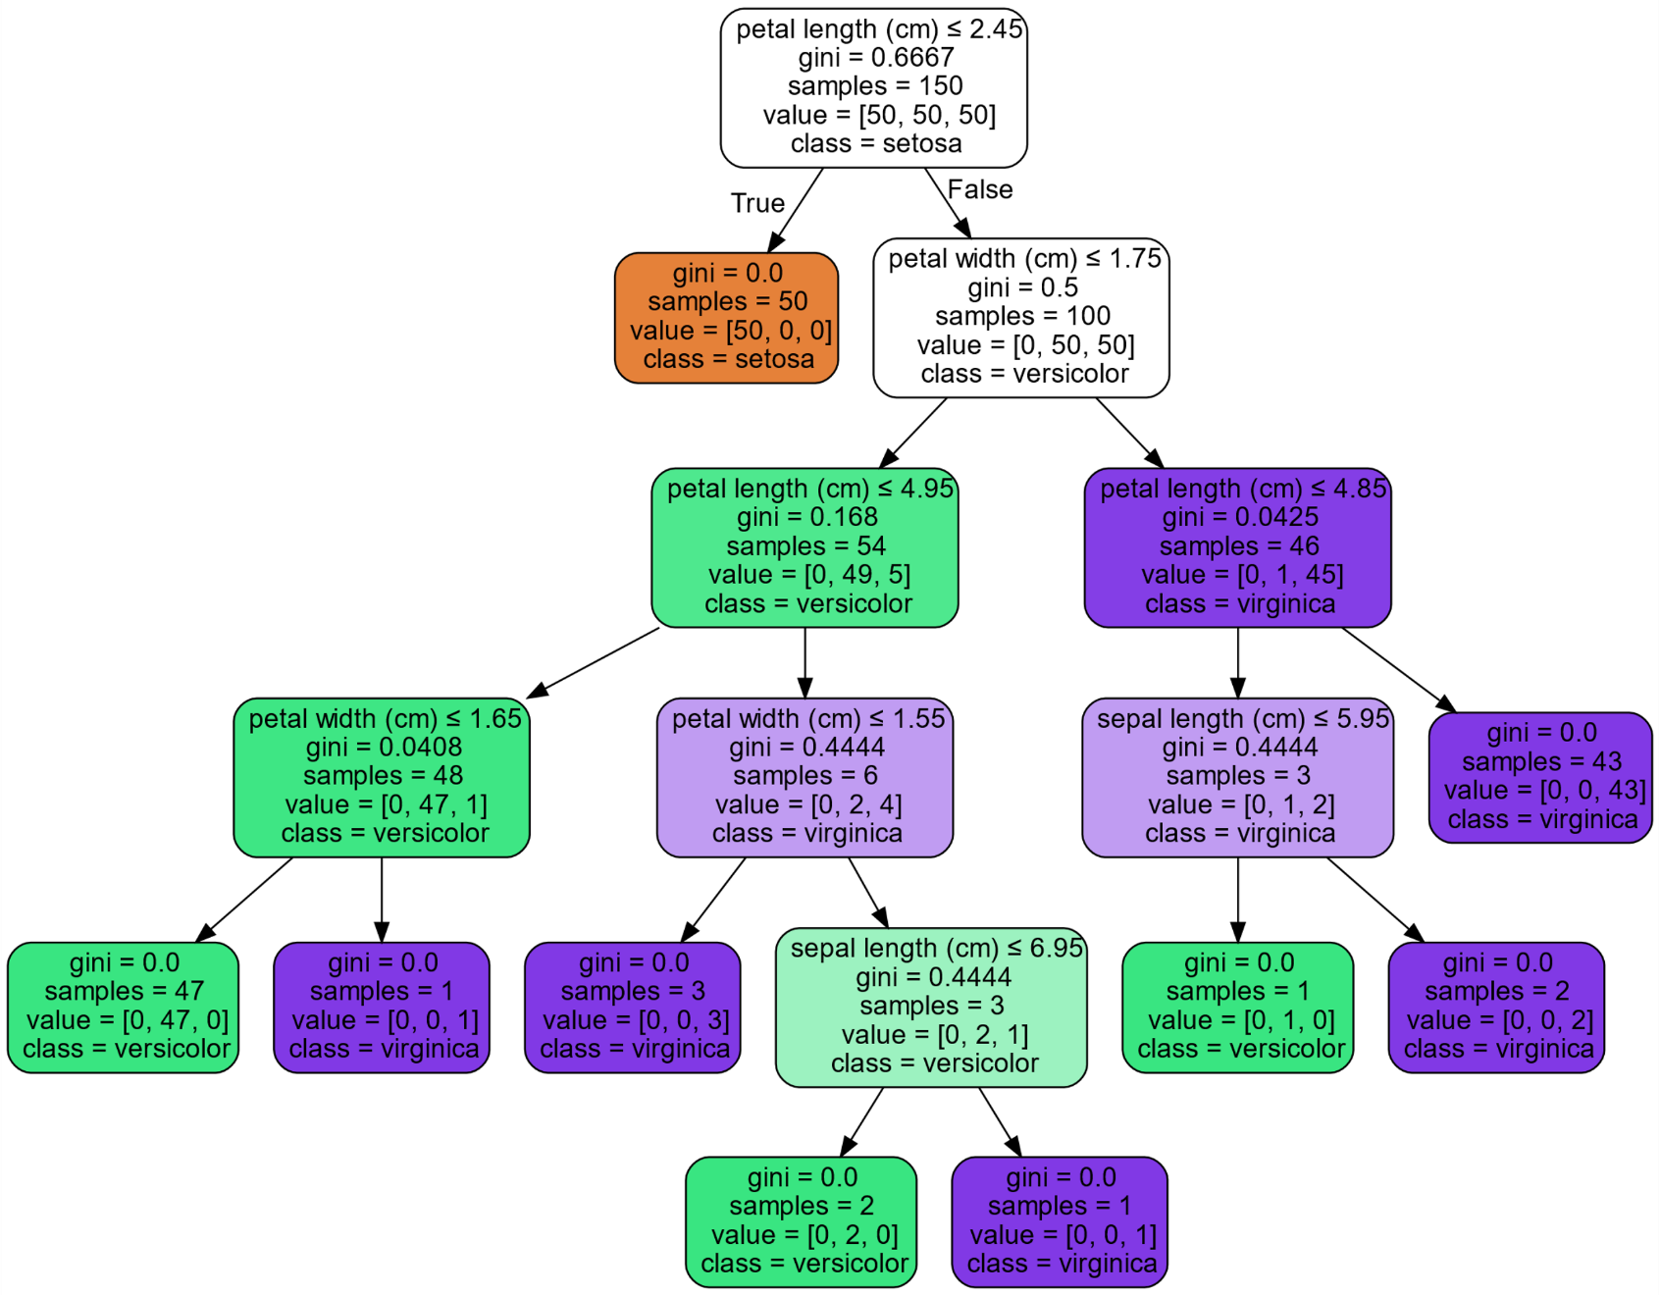
Tree Visualization Example (Iris Dataset)

Slide 30
Tips
Decision trees tend to overfit on data with a large number of features. Getting the right ratio of samples to number of features is important, since a tree with few samples in high dimensional space is very likely to overfit.
Consider performing dimensionality reduction (PCA, ICA, or Feature selection) beforehand to give your tree a better chance of finding features that are discriminative.
Visualize your tree as you are training by using the export function. Use max_depth=3 as an initial tree depth to get a feel for how the tree is fitting to your data, and then increase the depth.
Remember that the number of samples required to populate the tree doubles for each additional level the tree grows to. Use max_depth to control the size of the tree to prevent overfitting.

Slide 31
Tips (Continued)
Use min_samples_split or min_samples_leaf to control the number of samples at a leaf node. A very small number will usually mean the tree will overfit, whereas a large number will prevent the tree from learning the data. Try min_samples_leaf=5 as an initial value. If the sample size varies greatly, a float number can be used as percentage in these two parameters. The main difference between the two is that min_samples_leaf guarantees a minimum number of samples in a leaf, while min_samples_split can create arbitrary small leaves, though min_samples_split is more common in the literature.
Balance your dataset before training to prevent the tree from being biased toward the classes that are dominant. Class balancing can be done by sampling an equal number of samples from each class, or preferably by normalizing the sum of the sample weights (sample_weight) for each class to the same value. Also note that weight-based pre-pruning criteria, such as min_weight_fraction_leaf, will then be less biased toward dominant classes than criteria that are not aware of the sample weights, like min_samples_leaf.
If the samples are weighted, it will be easier to optimize the tree structure using weight-based pre-pruning criterion such as min_weight_fraction_leaf, which ensure that leaf nodes contain at least a fraction of the overall sum of the sample weights.

Slide 32
Python’s sklearn Documentation
http://scikit-learn.org/stable/modules/tree.html
http://scikit-learn.org/stable/modules/generated/sklearn.tree.DecisionTreeClassifier.html

